Slide 1
ADO.NET PROJECT

Slide 2
Team mates
1.INDRAJA REDDY
2.CHANDAN KUMAR
3.KULASEKHAR REDDY
4.SRIVANI

Slide 3

CREATING DATABASE *create database ADO PROJECT USE DATABASE *use ADO PROJECT
This Photo by Unknown Author is licensed under CC BY-NC

Slide 4
CREATE TABLES FOR EMPLOYEE,DEPARTMENT
→ Columns for EMPLOYEE table →Columns for DEPARTMENT table
* EMPID *DEPTID
*EMPNAME *DEPTNAME
*DOB *DEPTLOCATION
*PHONE *MANAGERID
*EMAIL
*SALARY
*DEPTID

Slide 5
→Inserted values to the tables
→created Buttons to the Form to Search the data from tables.
→created Update button in the form to update the data in the tables .
→Created Delete button in the form to delete the data in the tables.
→Created Insert button in the form to insert the values to the required table.

Slide 6
Inserting data to the employee table by using stored procedure
Inserted values using stored procedure.
Created stored procedure for Employee table
create procedure spinsertemployee
@eid int, @ename varchar(50), @dob date, @phone bigint, @email varchar(50),
@sal float, @deptid int
as
begin
insert into employee values(@eid,@ename,@dob,@phone,@email,@sal,@deptid)
end

Slide 7
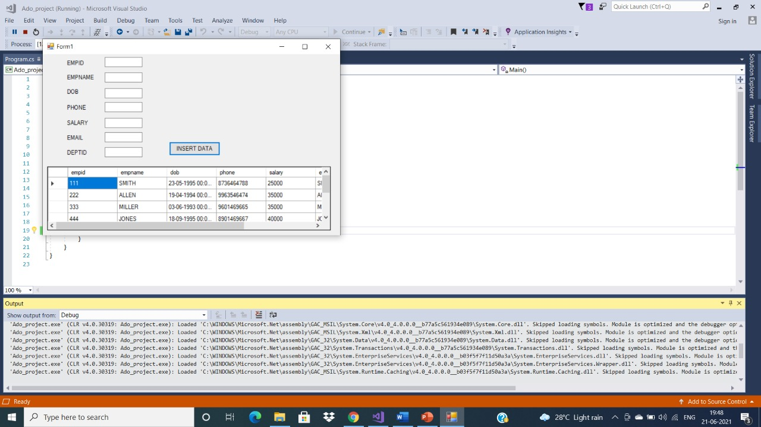
Form 1(insertion of emp table)

Slide 8
Inserted the data to the department table using stored procedure
create procedure spinsertdeparment
@deptid int, @deptname varchar(50), @deptlocation varchar(50),@managerid ini
as
begin
insert into department values(@deptid,@deptname,@deptlocation,@managerid)
end

Slide 9
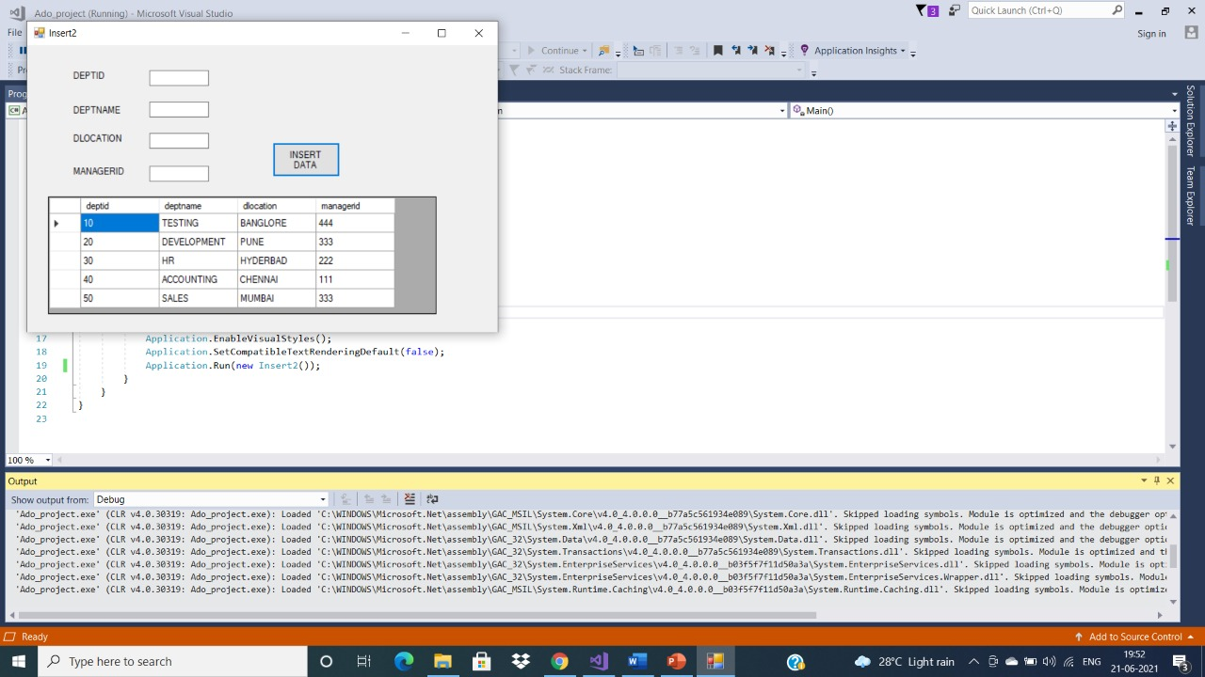
Insertion table for department

Slide 10
Search form
Drag two labels named it as EMPNAME and SALARY , two textboxes and Search button and a Datagridview to display the data.
We get the record according to the data given to the empname and salary textboxes.

Slide 11
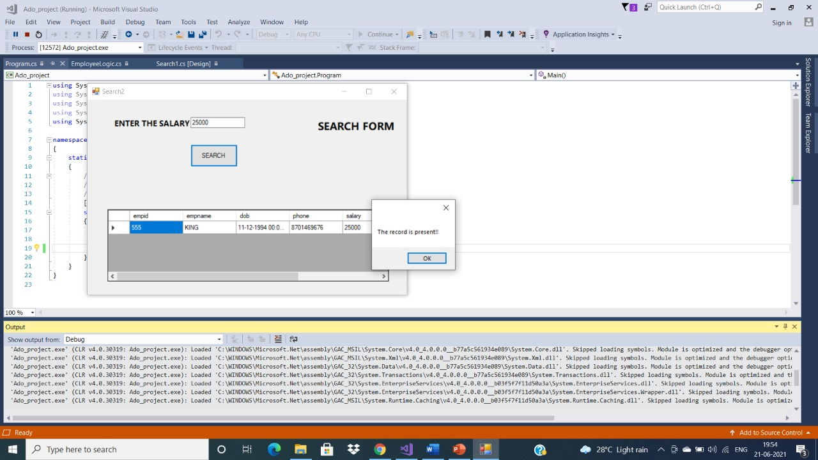
If we want to get the details of employee whose salary is 25000 we need to enter salary then click on searchsal we get the output employee

Slide 12
Update form
Drag labels named it as EMPID,EMPNAME,DOB,PHONE,EMAIL,SALARY,DEPTID
and seven textboxes and Update button and a Datagridview to display the data.
We get the record according to the data given to the EMPID,EMPNAME, DOB,PHONE,EMAIL,SALARY,DEPTID Textboxes

Slide 13
UPDATING data to the table
Updated values using stored procedure.
create proc spupdateemployee
(@EMPID INT,@EMPNAME VARCHAR(50),@DOB DATE,@PHONE BIGINT,@EMAIL VARCHAR(50),@SALARY FLOAT,@DEPTID INT)
AS
BEGIN
UPDATE EMPLOYEE SET EMPNAME=@EMPNAME, DOB=@DOB,PHONE=@PHONE, EMAIL=@EMAIL, SALARY=@SALARY, DEPTID=@DEPTID WHERE EMPID=@EMPID;
END

Slide 14
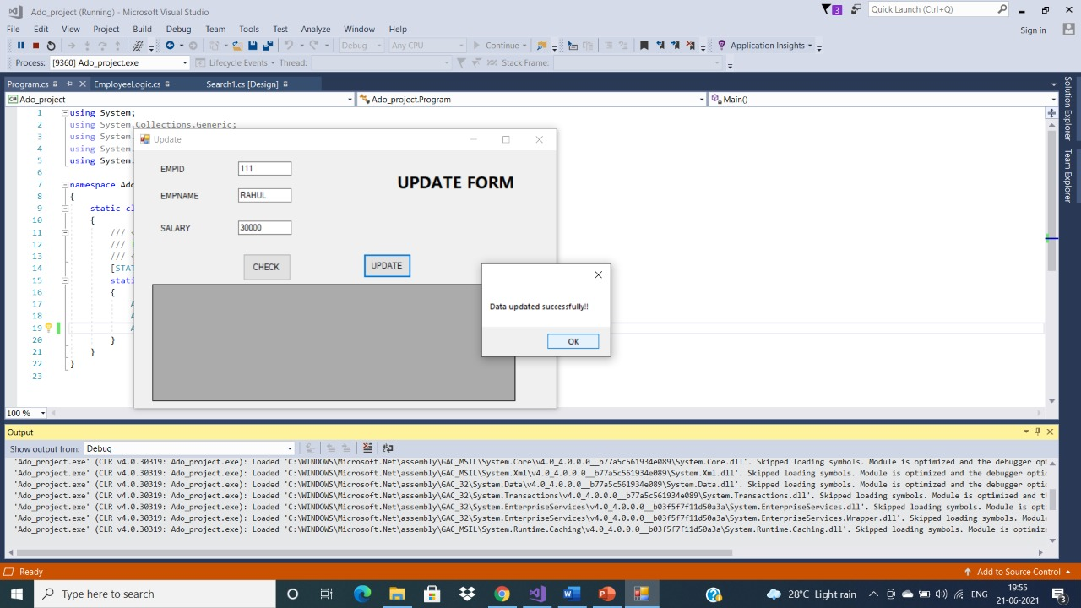
inserted value to the form to be updated

Slide 15
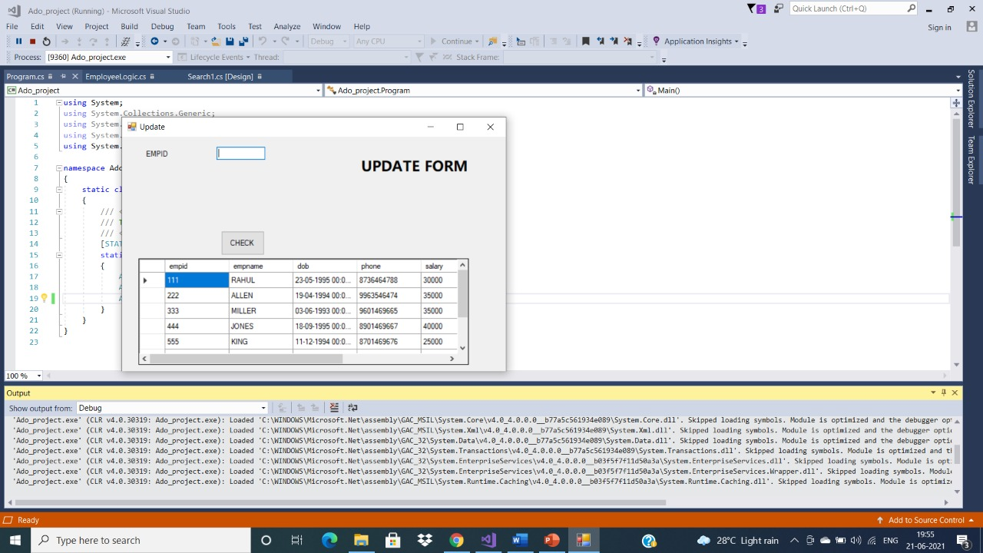
Click on update button then we can see updated data in the employee table

Slide 16
Updated data in department table

Slide 17
Delete the record
To delete the record the by using Delete command. First we have to enter the records whatever you want to delete.
After that we will click on Delete button the record will be deleted.

Slide 18
Delete the record

Slide 19
Join condition
To fetch the record from Employee and Department table by using inner join concept.

Slide 20
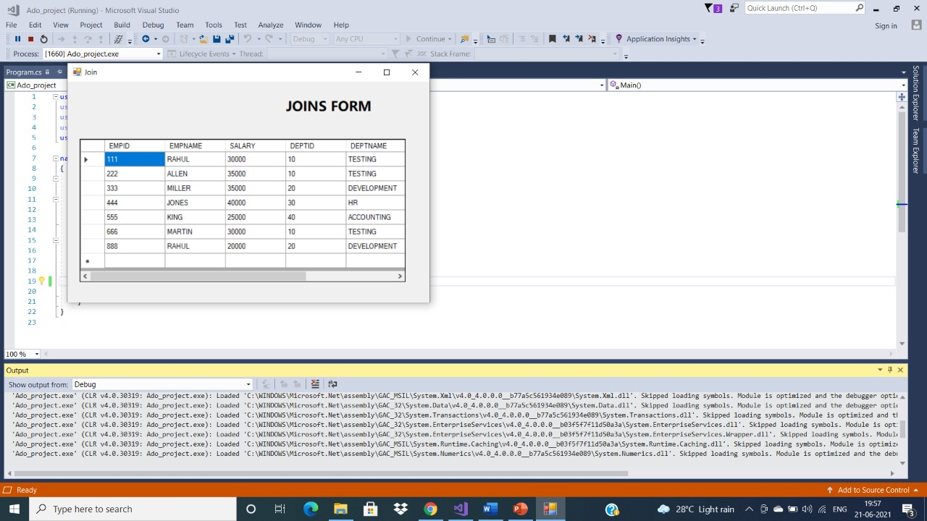
Output of join condition

